Slide 1
Rich Mirror Alignment
13/07/2015 Claire Prouve
How does it even work?
Implementation in the online framework
Current status

Slide 2
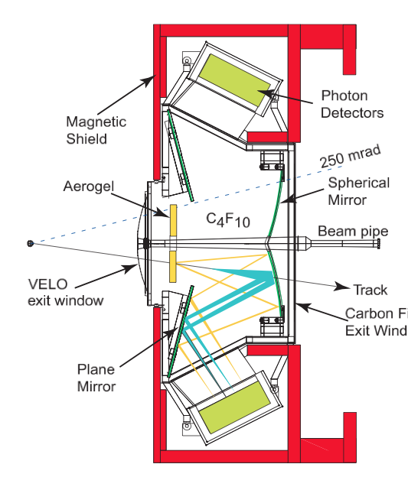
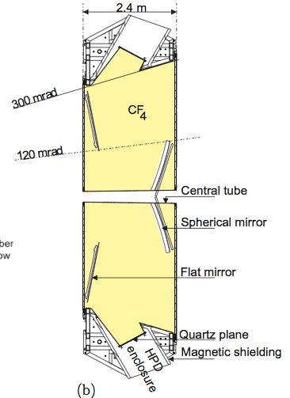
RICH Mirror Alignment
4 primary mirrors
16 secondary mirrors
RICH 1:
54 primary mirrors
40 secondary mirrors
RICH 2:
Secondary mirrors
Secondary mirrors
Primary mirrors
Primary mirrors
Misaligned mirrors will affect the PID due to incorrectly predicted Cherenkov angle!
Best possible resolution ~1.5mrad for RICH1, ~0.7mrad for RICH2.

Slide 3
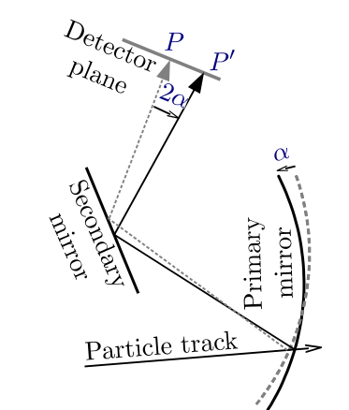
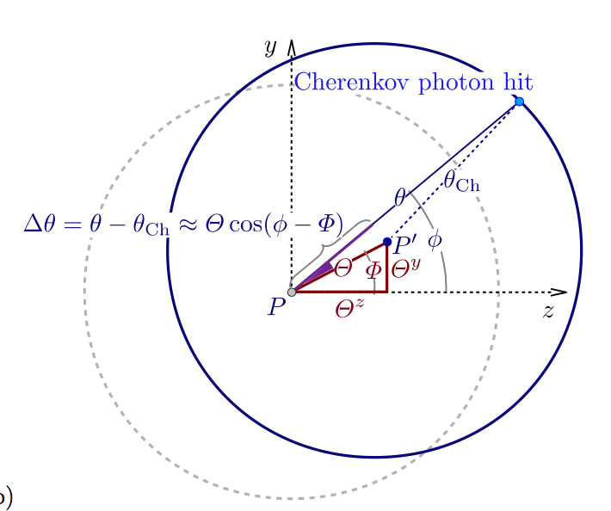

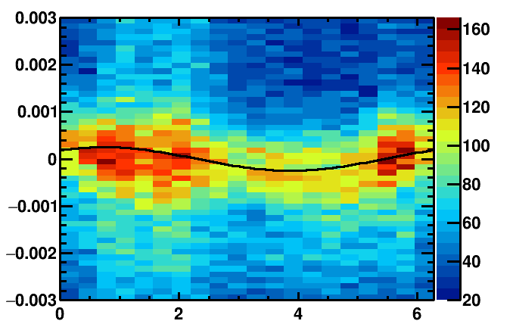
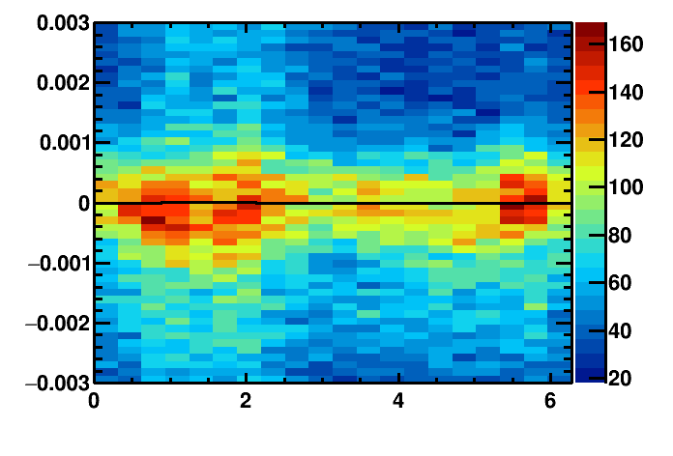
Misalignment
Identify misalignment:
Misalignment
Misalignments on detector plane
Proj. Track position
θ_{meas.}- θ_{exp.}
Real track position
Misaligned mirror:
Aligned mirror:
Cherenkov angle resolution / rad
Cherenkov angle resolution / rad
phi angle/ rad
phi angle/ rad

Slide 4
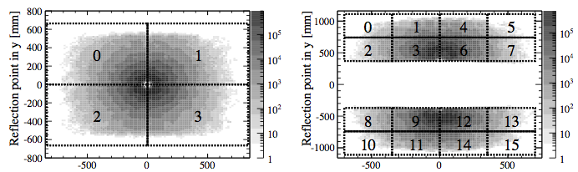
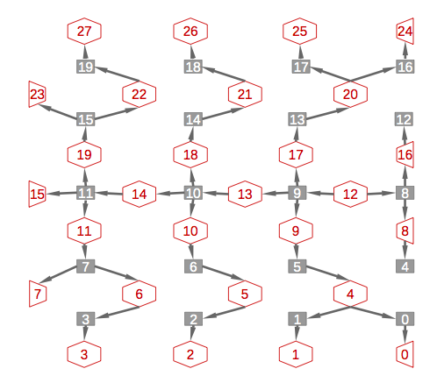
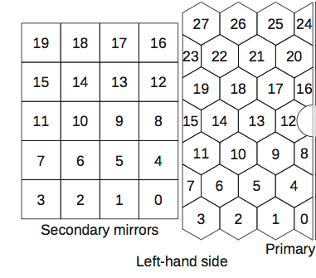
Aligning mirrors to each other
Primary mirrors
Secondary mirrors
RICH1: easy!
-> fix primary mirrors only align secondary mirrors
RICH2: more complicated
For a given secondary mirror several primary mirrors possible -> solve a set of simultaneous equations per half of RICH2
Andrew Cook
System of equations linking all primary
mirrors (red) and secondary mirrors(grey).

Slide 5
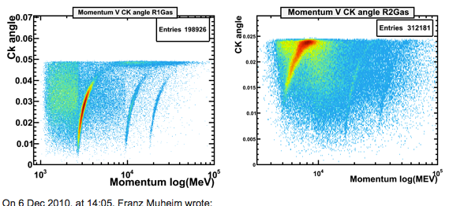
Alignment procedure
Select high momentum-tracks with pion hypothesis (p > 20GeV for RICH1, p > 40GeV for RICH2)
Reconstruct unambiguous photons for each necessary mirror pair
Fit Δθ(Φ) distributions
Calculate magnification coefficients by reconstructing same events for 8 different mirror tilts
Translate misalignments on detector plane into mirror-tilts using magnification coefficients
If changes for each mirror tilt smaller than threshold (0.1mrad) consider mirrors as aligned, otherwise restart at 1. with newly made alignment constants
Alignment usually converges after ~5 iterations
Unambiguous photons will be reflected by the same mirror-pair no matter where along the track they were emitted.

Slide 6
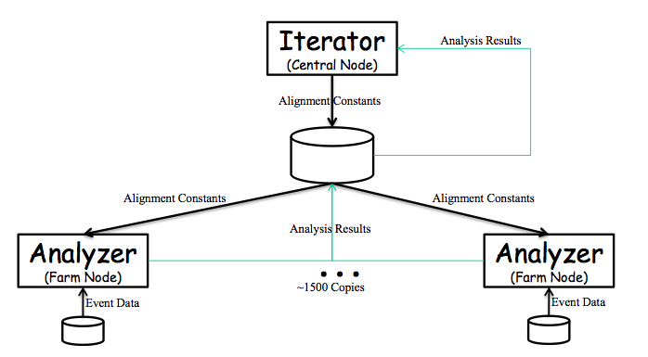
Use of online framework
Previously alignment done offline:
python driver script executed in ganga
ganga starts Brunel jobs + waits for them to finish
New alignment on the HLT farm:
Uses the online FSM (Finite State Machine)
Driver script: python Iterator
Brunel jobs: python Analyzer
Analyzers run on each node of the HLT farm (~1500)
Beat Jost

Slide 7
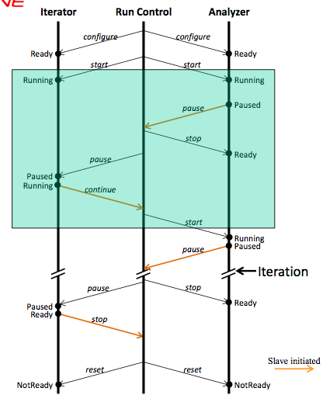
Use of online framework
Run control gives command to configure
When all analyzers and the iterator are configured run control gives command to start
Analyzers execute Brunel jobs
When all analyzers are finished they go to ready and write the rootfiles
The iterators goes to paused and sets everything up for the next iteration
The Iterator goes to running which makes the Analyzers run again (this time with a different mirror-xml file as input)
After 9 of these iteration the iterator calculates the magnification coefficients, fits the mirror tilts, calculates the new mirror constants and determines if the alignment has converged
If no: set up next iteration with new xml file and start at 3.

Slide 8
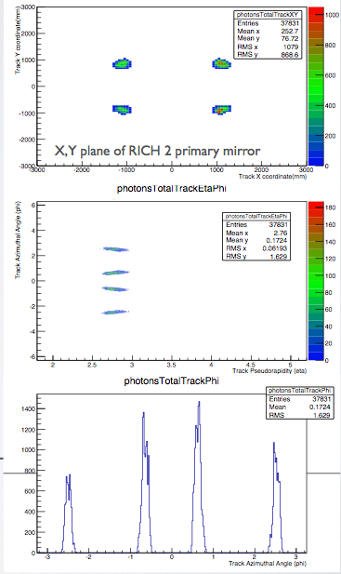
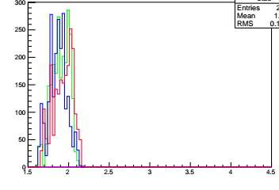
New HLT Lines
RICH2
Triggers on tracks that will populate the hardest-to-populate mirror-pairs
usually the very outer mirrors
Other tracks in the events will populate the rest
Track azimuthal angle / rad
RICH2 line:
p > 40 GeV && χ² < 2 && 2.59 < η < 2.97
(-2.69 < Φ < -2.29) || ( -0.85 < Φ < -0.45) || (0.45 < Φ < 0.85) || (2.29 < Φ < 2.69)
Track pseudorapidity
RICH1
RICH1 line:
p > 10 GeV && χ² < 2 && 1.6 < η < 2.04
(-2.65 < Φ < -2.3) || (-0.8 < Φ < -0.5) || (0.5 < Φ < 0.8) || (2.3 < Φ < 2.65)
Need to reconstruct ~10 times less events!
Track pseudorapidity

Slide 9
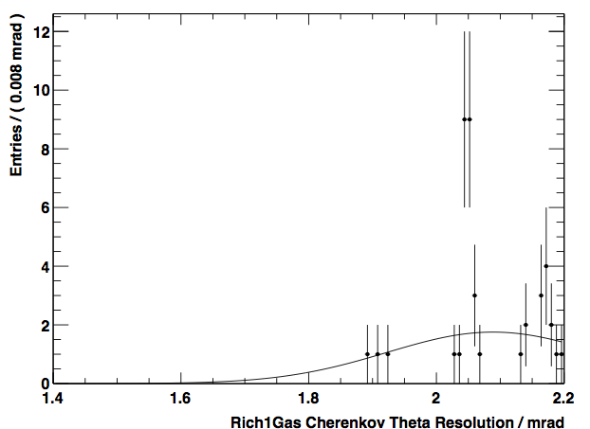
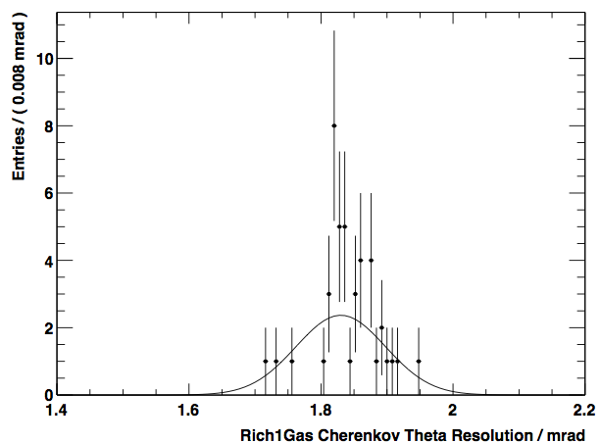
Current Status
Currently used alignment:
Made offline on data taken on 12 – 14/06 (second weekend of data taking)
Data from ‘old’ HLT1 line (suboptimal for RICH1)
RICH1: 2.1mrad to 1.85mrad
RICH2: 0.73mrad to 0.72mrad
RICH1 before alignment
RICH1 after alignment
Chris Jones
Chris Jones

Slide 10
Current Status
Online alignment functioning (with some hand-holding)
~ 8 times faster than offline alignment
New alignment for RICH1
On the 50ns data
With new HLT lines in place
More than enough entries in all histograms!!!
Before new online alignment:
After new online alignment:
σ = 1.59 mrad
σ = 1.72 mrad

Slide 11
Summary
Online alignment running
Decent alignment being used already (res. of 1.85/0.72 mrad for RICH1/RICH2)
Better alignments on the way
Without Roel we would all be lost
To do:
Implement monitoring
Stabilize the fitting of the histograms
Run online alignment fully automatically
Magnet polarity test

Slide 12
Backup

Slide 13
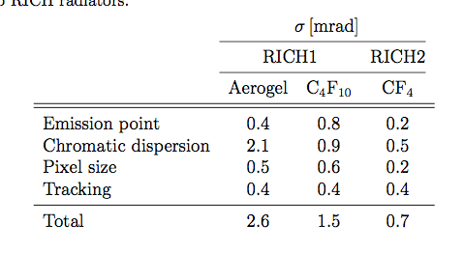
Cherenkov angle resolution
Limiting factors to Cherenkov angle resolution:

Slide 14


Magnification coefficients
Magnification coefficients: Translate the tilt on the detector plane into actual mirror tilts
Magnification coefficients are calculated new for each iteration:
Introduce 8 rotations: primary and secondary mirrors rotated around ±y and ±z axis respectively
Rotate about 0.3 mrad ( half the resolution of RICH2)
Reconstruct events for each rotation and evaluate the tilts on the detector plane
Need to reconstruct all events 9 times!
Misalignments on detector plane
Mirror tilts

